Slide 1
Predicting Used Car Sale Price
By: Priyanka

Slide 2


Slide 3
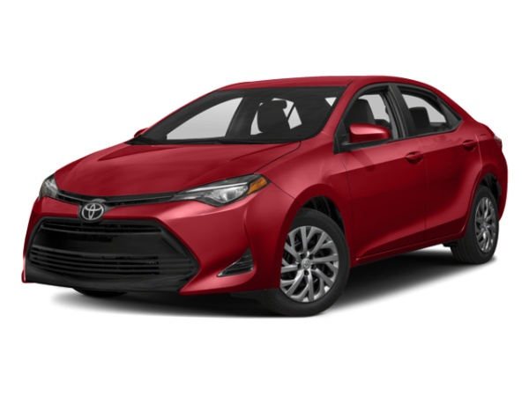
Problem
To predict the sale prices of the used cars by Regression Analysis.

Slide 4

Data Source
Tools Used
Beautiful Soup
Selenium
Python
TRUECar.com

Slide 5
Approach
Phase I
Data Scraping
Total 2400 records
Phase 2
Preprocessing (Cleaning up of Data)
Linear Regression Modelling
Notes:
The approach for this project is divided in 2 phases.

Slide 6
What are the important features for buying an used car ?

Slide 7
Features
Miles
Year
Mileage
Drive Type
Fuel Type
Transmission
Make
Price

Slide 8
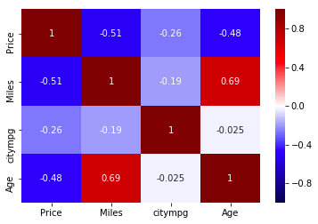
Heatmap of correlations of different variables

Slide 9
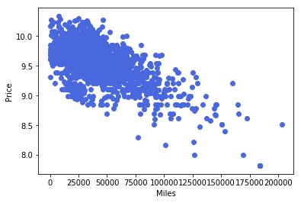
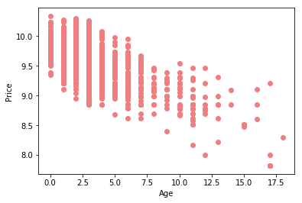
Identifying the relationships
Miles & Age of the Car has negative linear relationship with the Price.
R-squared = 0.412

Slide 10
How to make the model Better ?
Step 1 : Adding the Categorical Features to the model
DriveType (eg: AWD)
Fuel Type (eg: Gas, Electric)
Transmission (eg: Automatic / Manual)
Make (eg: Toyota, Acura)

Slide 11
How to make the model Better ?
Step 2: Filtering Features based on the P-values
Step 3: Log Transformation of Price and Mileage
Step 4: Linear regression equation
Log_price = Intercept + Miles + Age + Drive_Type + Fuel_Type + Transmission + log_mileage + Make + error

Slide 12
Analysis Results
Features | Y | R-squared
Miles, Age, citympg | Price | 0.412
Miles, Age, citympg | log_price | 0.535
Miles, Age, cmpg | log_price | 0.551
Miles, Age, cmpg, Transmission, DriveType, FuelType | log_price | 0.659
Miles, Age, cmpg, Transmission, DriveType, FuelType, Make | log_price | 0.783

Slide 13
Validation of Model Fit
Method 1 - Train Test Split:
Test Size = 0.3 and R2 - 0.76
Method 2 - K Fold Cross Validation
No. of Folds = 10 and Negative Mean square error:
0.01699254 | 0.01911247 | 0.01816511 | 0.01077759 | 0.01878454
0.01643488 | 0.03007102 | 0.02184408 | 0.01997314 | 0.01815298
Notes:
We want to validate our model fit is in right direction. To test this these are 2 methods.

Slide 14
Avoid Overfitting Model
Model Trained with Lasso Regularization for Feature Selection and optimal model.
R-squared: 0.76
Notes:
We dont want to overfit our model as this wont generalize our model with other datasets. This we have achieved by Lasso Regularization of our model by doing Feature selection.

Slide 15
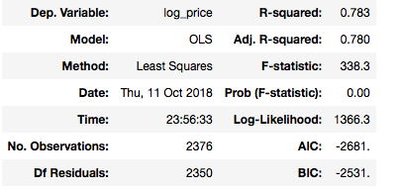
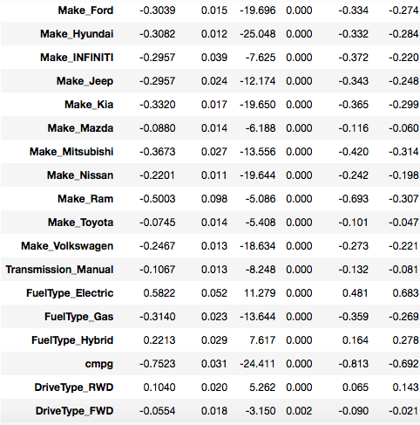
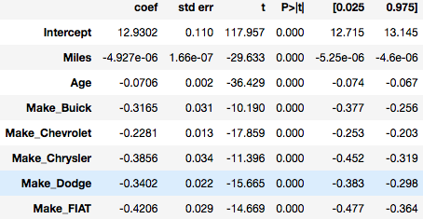
Final Results
Features
Features

Slide 16
Next Steps
Add more features like Premium Package, Engine Types.
Trend in sale price based on location of cars
Regression Modelling of Luxury cars
Add more data to the dataset

Slide 17
Questions ???
Thank You

